Slide 1
Basics of DNA

Slide 2
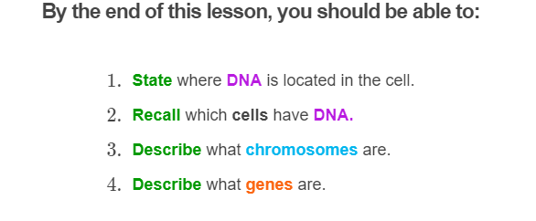
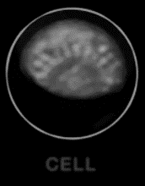

Slide 3
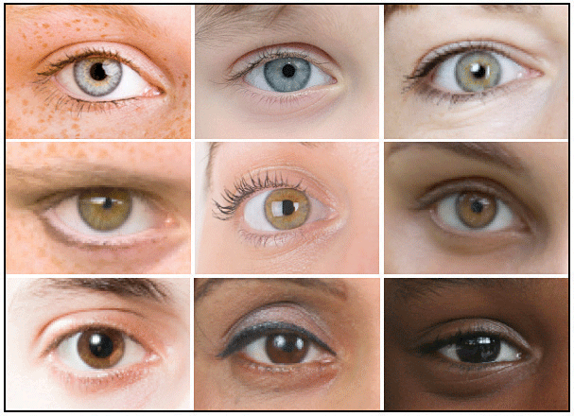
Each person has characteristics, such as eye colour, which make them different and identifiable.
Different variations of characteristics are known as traits - for example, blue, brown and green eyes are all traits.
Your traits are determined by a special molecule called deoxyribonucleic acid, or DNA for short.

Slide 4

DNA is very small and cannot be seen with the naked eye.
However, if you could see it, it would look similar to yarn. It is a long, spiralling string.

Slide 5
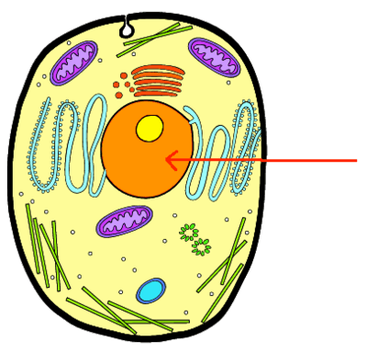
DNA is located in the nucleus of your cells.
In the picture below, an arrow is pointing to the nucleus.

Slide 6
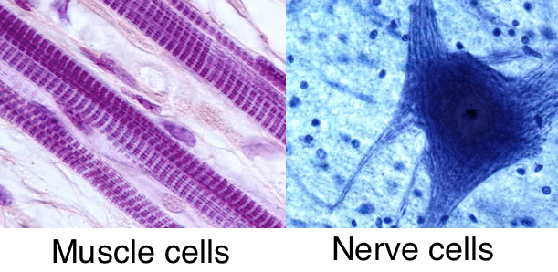
Every one of your cells has DNA. That DNA is also exactly the same.
For instance, your muscle cells and your nerve cells both carry DNA. If you could look at that DNA, you would find the DNA from a muscle cell was exactly the same as the DNA from a nerve cell.
So every cell in your body has an identical copy of your DNA.

Slide 7
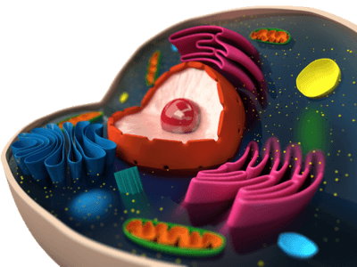
In summary:
• | Your traits are determined by a molecule called DNA.
• | DNA looks like a long string.
• | It is located in the nucleus of each cell in your body.

Slide 8
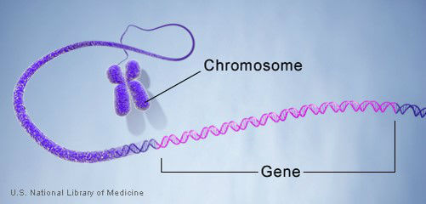
Along the DNA molecule are genes.
Genes are lengths of DNA that come one after the other, like beads on a necklace. They carry the information that determine your traits.
One gene may dictate your eye colour, another your hair colour, and another your blood type. Thousands of genes are located in your DNA.

Slide 9
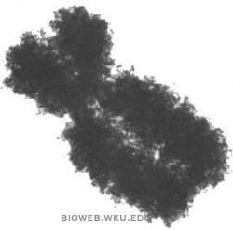
A string of DNA can be wound up, or condensed, into structures called chromosomes.
One chromosome is made from a single, long string of DNA.
If DNA is yarn, then chromosomes are like balls of yarn, used to organize the DNA.

Slide 10

Like you can have several balls of yarn, you can have several chromosomes in the same cell.
Humans have 46 chromosomes in the nucleus of each and every one of their cells.

Slide 11
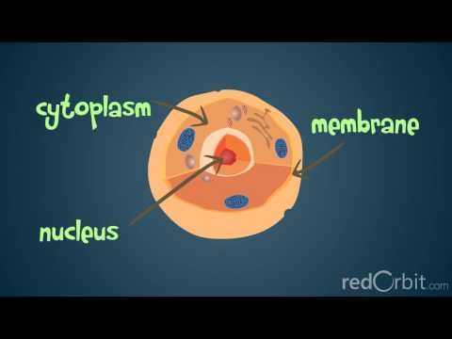

Slide 12
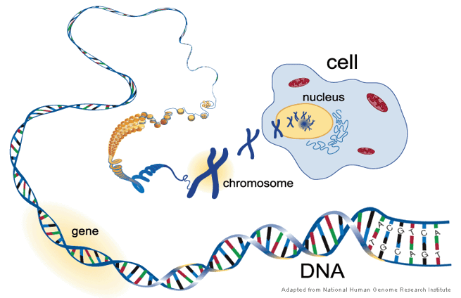
In summary:
• | DNA is a molecule containing many genes, which hold information about your traits.
• | When condensed (wound up) it forms a structure called a chromosome.

Slide 13
